Slide 1

Technology in Action
15th Edition
Chapter 3
Using the Internet: Making the Most of the Web’s Resources
Notes:
If this PowerPoint presentation contains mathematical equations, you may need to check that your computer has the following installed:
1) MathType Plugin
2) Math Player (free versions available)
3) NVDA Reader (free versions available)

Slide 2
Learning Objectives (1 of 3)
3.1 Describe how the Internet got its start.
3.2 Explain how data travels on the Internet.
3.3 Evaluate the tools and technologies used to collaborate on the web.
3.4 Summarize the technologies used to communicate over the web.
3.5 Describe how business is conducted using the Internet.
3.6 Summarize precautions you should take when doing business online.
Notes:
Slide 2 is a partial list of textbook Learning Objectives numbers and statements.

Slide 3
Learning Objectives (2 of 3)
3.7 Explain what web browsers are, and describe their common features.
3.8 Explain what a URL is, and discuss its main parts.
3.9 Describe tools used to navigate the web.
3.10 Describe the types of tools used to search the web, and summarize strategies used to refine search results.
3.11 Describe how to evaluate a website to ensure it is appropriate to use for research purposes.
Notes:
Slide 3 is a continued list of textbook Learning Objectives numbers and statements.

Slide 4
Learning Objectives (3 of 3)
3.12 Demonstrate an understanding of the ethical issues regarding digital activism.
3.13 Demonstrate an understanding of the ethical issues regarding location tracking applications and devices.
Notes:
Slide 4 is the final list of textbook Learning Objectives numbers and statements.

Slide 5
The Internet and How it Works The Origin of the Internet (Objective 3.1)
The Internet is a network of networks
Established a secure form of communications
Created a means of communication for all computers
Advanced Research Projects Agency Network (ARPANET)
Notes:
The Internet is a network of networks connecting billions of computers globally.
The U.S. Department of Defense needed a computer system that wouldn’t be easily disrupted in the event of an attack.
Two concerns were addressed: establishing a secure form of communications and creating a means by which all computers could communicate.
The modern Internet evolved from a U.S. government–funded project called the Advanced Research Projects Agency Network.

Slide 6
The Internet and How it Works How the Internet Works (Objective 3.2)
Client/Server network
Client asks for data
Server receives request and returns data
Internet backbone
Internet Protocol (IP) address
How computers identify each other
Websites have unique IP addresses
Text versions of IP addresses
Notes:
In a client/server network, the client asks for data and the server provides the data.
When connected to the Internet, your computer is assigned a unique number called an Internet Protocol address, which is a set of four groups of numbers separated by periods, such as 123.45.245.91, referred to as a dotted quad or dotted decimal.
IP addresses are how computers identify each other. Each website is assigned an IP address. Because IP addresses are difficult for people to remember, websites are given text versions of their IP addresses.

Slide 7
Collaborating and Communicating on the Web Collaborating with Web Technologies (1 of 3) (Objective 3.3)
Web 2.0
Social Web
Collaboration tools
Social media
Social Networking
Facebook
Twitter
Privacy precautions
Notes:
The new collaborative, user-created web content has been dubbed Web 2.0.
Web 2.0 can be classified as social media and include social networking, wikis, blogs, podcasts, and webcasts.
Social networking is using the web to communicate and share information.
Social networking services have become popular.
You need to be aware of many precautions as you use social networking sites.

Slide 8
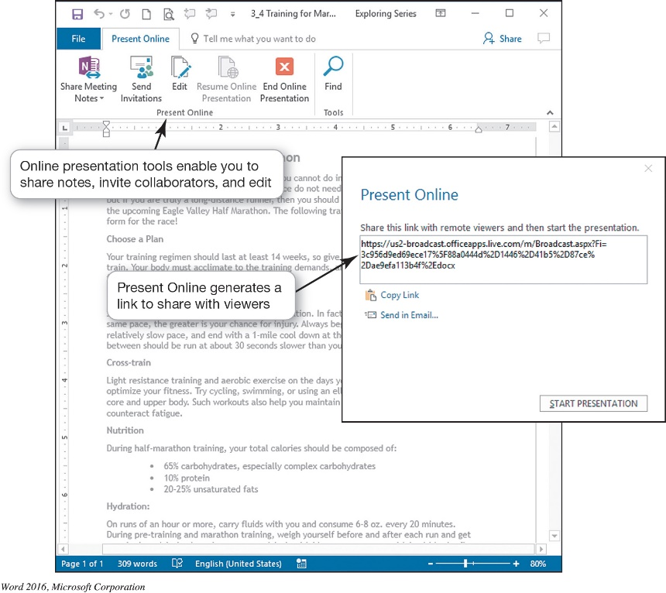
Collaborating and Communicating on the Web Collaborating with Web Technologies (2 of 3) (Objective 3.3)
Project Collaboration and File Sharing Tools
Wikis: Collaborative Web-based documents
Project Management Tools
Blogs
Blog (weblog)
Video log (vlog)
Create your own blog
Problems with blogs
Microblogs
Notes:
Wikipedia is one example of a wiki, a web application that allows users to add, remove, or edit its content.
Google Drive has wiki-like features to promote similar online collaboration, and specific wiki software, such as Wikispaces and MediaWiki.
The Wikimedia Foundation hosts other collaborative projects, such as Wikibooks, Wikiversity, and Wikisource.
Project management tools incorporate tasks and calendars so the individual components as well as the entire project can stay on schedule.
A blog (short for weblog) is a personal log or journal posted on the web.
A video log (vlog or video blog) is a blog that uses video as the primary content.
You can easily create your own blog.
Problems with blogs include spam blogs (splogs).
Microblogs are blogs with limits on how much text can be used.

Slide 9
Collaborating and Communicating on the Web Collaborating with Web Technologies (3 of 3) (Objective 3.3)
Podcasts
Audio/video files delivered via RSS
RSS: Really Simple Syndication
Aggregator
Webcasts
Broadcast of audio or video content over the Internet
Media Sharing Platforms
YouTube, Flickr, Instagram, Sound Cloud
Notes:
A podcast is a form of digital media composed of a series of audio or video files that are distributed over the Internet.
Podcasts deliver their content using Really Simple Syndication, a format that sends the latest content of the podcast series automatically to an aggregator. An aggregator locates all the RSS series to which you’ve subscribed and automatically downloads the new content.
A webcast is the broadcast of audio or video over the Internet.
There are several media sharing platforms such as: YouTube, Flickr, Instagram, and Sound Cloud.

Slide 10
Collaborating and Communicating on the Web Communicating over the Web (1 of 2) (Objective 3.4)
E-mail
Primary means of communication
Written message sent or received
Asynchronous
Convenient
Not private
Etiquette
Web-based E-mail
E-mail client
Notes:
E-mail is the primary means of communication over the Internet because it is fast and convenient. E-mail is a written message sent or received over the Internet.
It is asynchronous, so users do not need to be communicating at the same time.
E-mail is convenient for exchanging and collaborating on documents via attachments.
It is a more private exchange of information than public social networking sites, but e-mails are not really private.
When you send e-mail for professional reasons, you should use proper e-mail etiquette.
There are two types of email: Web-based and using an E-mail client.

Slide 11

Collaborating and Communicating on the Web Communicating over the Web (2 of 2) (Objective 3.4)
Communicate in real time
Instant Messaging
Texting
VoIP
Notes:
Instant messaging services let you communicate in real time over the Internet.
AIM, Google Chat, Windows Messenger, and Yahoo! Messenger are proprietary IM services, meaning you can chat with only those who share the same IM service and are on your contact or buddy list.
There are universal chat services that you install, which allow you to chat with users of all popular IMs.
Texting is the sending of messages between devices.
Voice Over Internet Protocol (VOIP) uses the Internet to make phone calls.

Slide 12
Conducting Business on the Web Conducting Business Online (Objective 3.5)
Business-to-consumer (B2C)
Business-to-business (B2B)
Consumer-to-consumer (C2C)
Social commerce
Mobile commerce
Notes:
There are three types of e-commerce business models:
1. Business-to-consumer (B2C) transactions take place between businesses and consumers.
2. Business-to-business (B2B) transactions occur when businesses buy and sell goods and services to other businesses.
3. Consumer-to-consumer (C2C) transactions occur when consumers sell to each other.
Social commerce is a subset of e-commerce that uses social networks to assist in marketing and purchasing products.
Mobile commerce (or m-commerce) is conducting commercial transactions online through a smartphone, tablet, or other mobile device.

Slide 13
Conducting Business on the Web E-Commerce Safeguards (Objective 3.6)
Guidelines to make shopping safer
Secure website
Secure sockets layer protocol
Well-known, reputable sites
Pay by credit card, not debit card
Return policy
Avoid using public computers
Notes:
E-commerce is short for electronic commerce and is the process of conducting business online.
Guidelines to make online shopping safer:
Look for indicators that the website is secure. Check that the beginning of the URL changes from “http://” to “https://”.
Shop at well-known, reputable sites.
Pay by credit card, not debit card.
Check the return policy, and save a copy of the order and confirmation number.
Avoid making online transactions when using public computers.

Slide 14
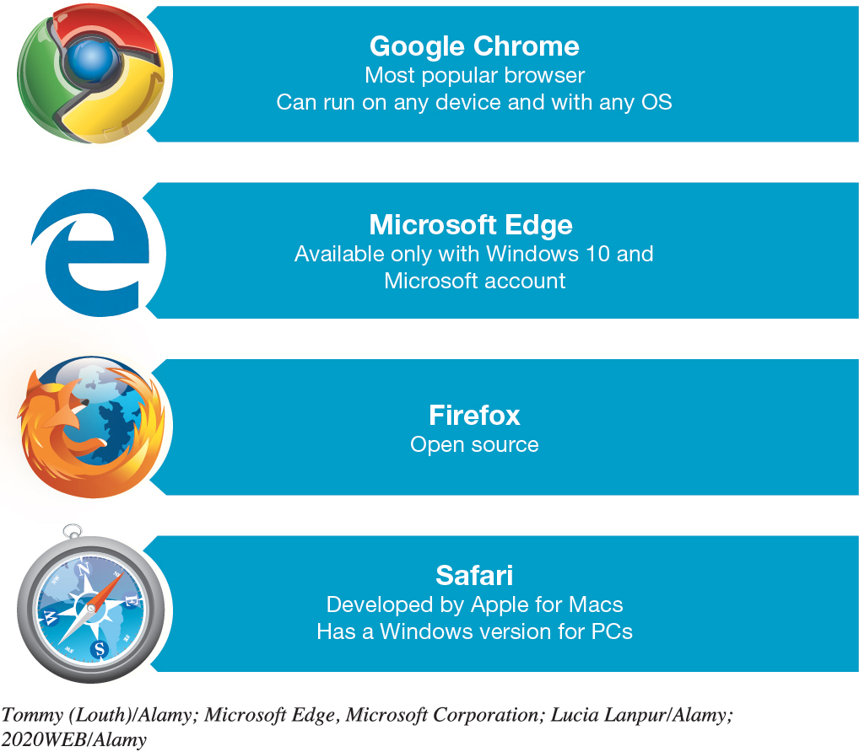
Accessing and Moving Around the Web Web Browsers (Objective 3.7)
Web browsers
Graphical browsers
Features
Notes:
A browser is software that lets you locate, view, and navigate the web.
Most browsers today are graphical browsers, meaning they can display pictures (graphics) in addition to text and other forms of multimedia such as sound and video.
Most popular browsers offer similar features.

Slide 15
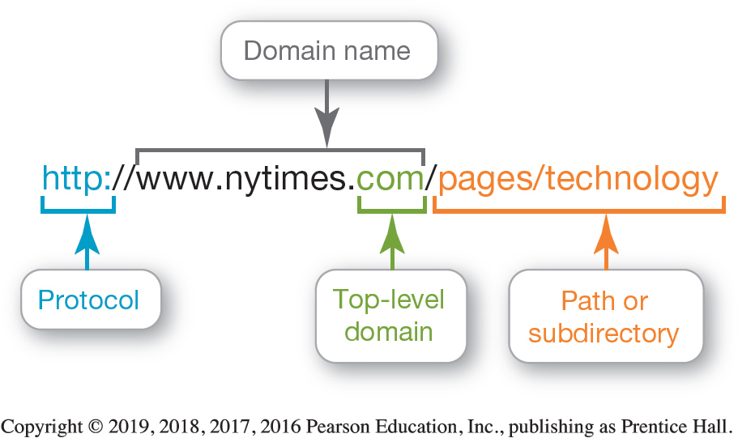
Accessing and Moving Around the Web URLs, Protocols, and Domain Names (Objective 3.8)
Every website has a unique address
URLs are composed of parts to identify the web document
Protocols
Hypertext Transfer Protocol
File Transfer Protocol
Domain Name
Top-level domain
Notes:
You access a website by typing its Uniform Resource Locator (URL) in your browser.
A URL has several parts that help identify the web document it stands for:
Protocol (set of rules) used to retrieve the document
Domain name
Path or subdirectory
You don’t have to type in every part in the location or address bar of the browser.
When the URL is only the domain name, you’re requesting a site’s home page.
The suffix in the domain name after the dot is called the top-level domain.

Slide 16
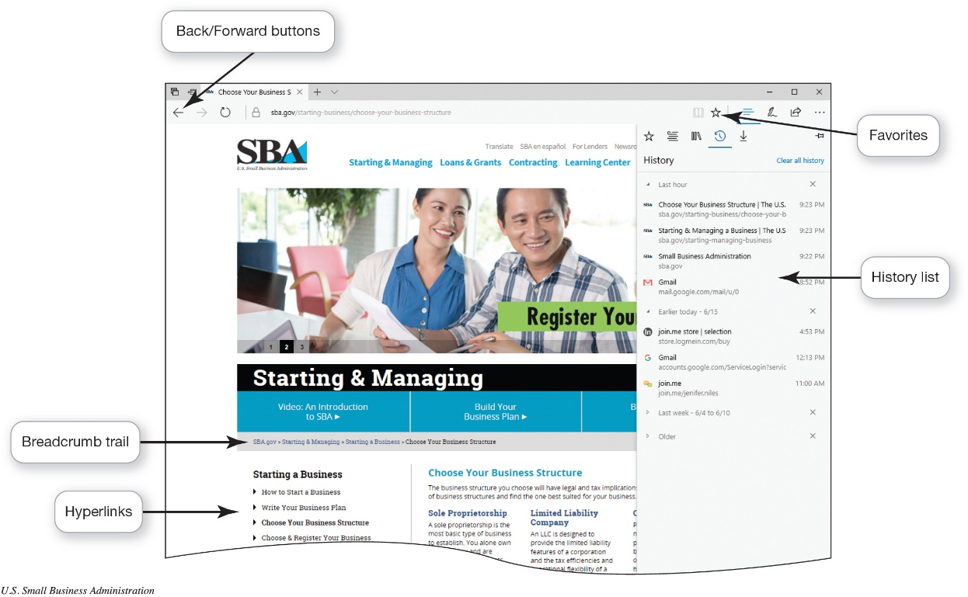
Accessing and Moving Around the Web Navigating the Web (Objective 3.9)
Hyperlinks
Breadcrumb trail
Bookmarks
History
Tagging
Social bookmarking
Delicious.com
Notes:
Hyperlinks are specially coded elements that let you jump from one web page to another within the same website or to another site altogether.
To help you navigate more quickly through a website, some sites provide a breadcrumb trail—a navigation aid that shows users the path they have taken to get to a web page.
The History list shows all the websites and pages you’ve visited over a certain period of time.
The Bookmarks feature allows you to return to a specific web page without having to remember the address.
Live bookmark is a feature in Firefox that adds the technology of RSS feeds to bookmarking.
Tagging, known as social bookmarking, saves your favorite website to a social bookmarking site so that you can share it with others.

Slide 17
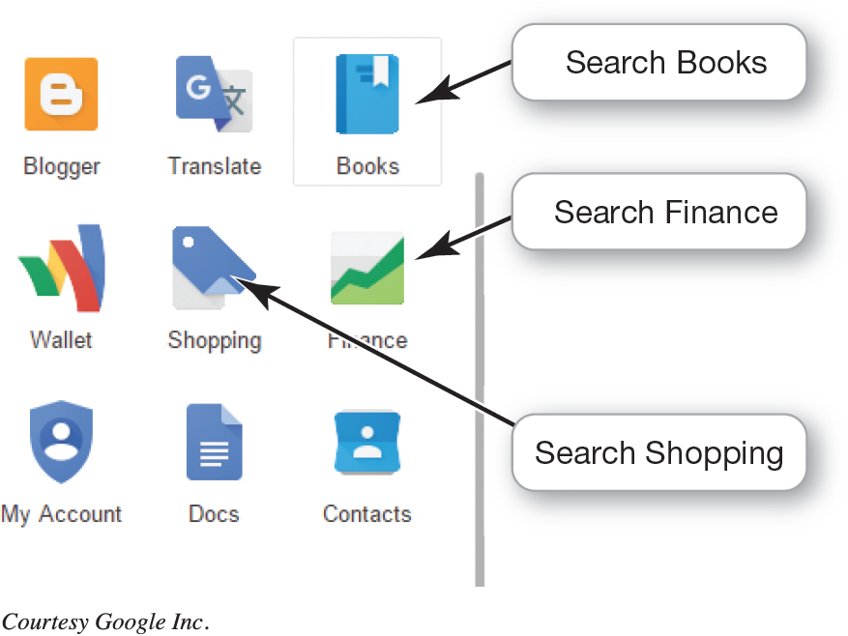
Searching the Web Effectively Using Search Engines (1 of 2) (Objective 3.10)
Search engine
Keywords
Spider
Indexer
Search engine software
Specialized search engine
Metasearch engine
Notes:
A search engine is a set of programs that searches for keywords and returns a list of the websites on which those keywords are found.
Specialty search engines search only sites that are relevant to a particular topic or industry.
Metasearch engines search other search engines rather than individual websites.

Slide 18
Searching the Web Effectively Using Search Engines (2 of 2) (Objective 3.10)
Obtaining better search results
Boolean operators
Search for a phrase
Search within a website
Use a wild card
Notes:
You can obtain better search results by using the following:
Boolean operators
Search for a phrase
Search within a website
Use a wild card

Slide 19
Searching the Web Effectively Evaluating Websites (Objective 3.11)
Internet resource considerations
Authority
Bias
Relevance
Audience
Links
Notes:
Before you use an Internet resource, consider:
Authority: Who is the author of the article or the sponsor of the site?
Bias: Is the site biased?
Relevance: Is the information in the site current?
Audience: For what audience is the site intended?
Links: Are the links available and appropriate?
The answers will help you decide whether you should consider a website to be a good source of information.

Slide 20
Using the Web Ethically Digital Activism (Objective 3.12)
Digital Activism
Raise awareness about specific issues
#IceBucketChallenge
#BringBackOurGirls
Ethical question: Is digital activism effective or does it foster a false sense of involvement?
Notes:
Digital Activism is used to raise awareness about specific issues. Some recent one have been:
#IceBucketChallenge
#BringBackOurGirls
Ethical question: Is digital activism effective or does it foster a false sense of involvement?

Slide 21
Using the Web Ethically Geolocation (Objective 3.13)
Smartphones use a GPS chip to calculate your position
Geolocation
Targeting consumers by their location
Used by third party advertising networks
Can be a violation of privacy rights
No specific laws yet to address privacy issues
Ethical Question: Are geolocation devices a threat to privacy?
Notes:
The technology is called geolocation (see Figure 3.24), and most mobile devices have a GPS chip that can calculate your exact position.
No specific laws have been passed to insure personal privacy.
Ethical Question: Are geolocation devices a threat to privacy?

Slide 22
Questions
?

Slide 23
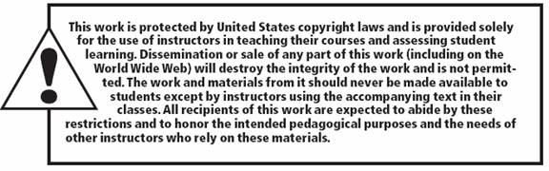
Copyright
All rights reserved. No part of this publication may be reproduced, stored in a retrieval system, or transmitted, in any form or by any means, electronic, mechanical, photocopying, recording, or otherwise, without the prior written permission of the publisher. Printed in the United States of America.

